Slide 1


CS 235: User Interface Design March 5 Class Meeting
Department of Computer Science San Jose State University Spring 2015 Instructor: Ron Mak
www.cs.sjsu.edu/~mak

Slide 2
Schedule for Prototype Presentations
Thursday, March 12
Innovative Designers
Team Four
Thundercats
Tuesday, March 17
Unknown
UXability
X Factor

Slide 3
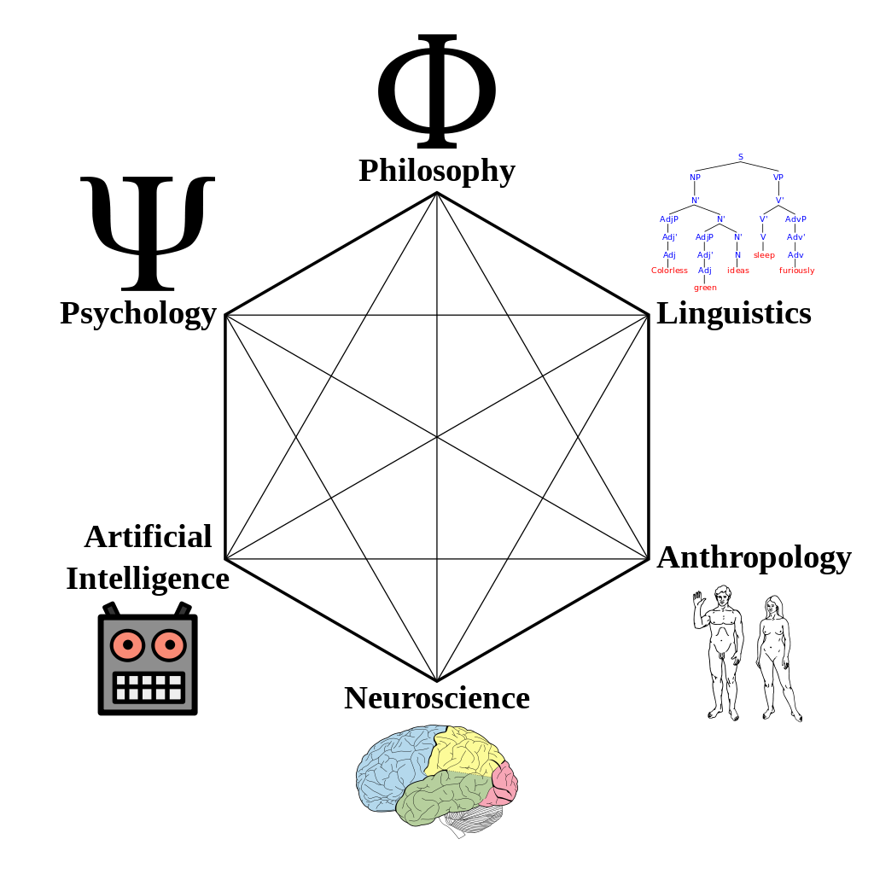
Cognitive Science
The interdisciplinary study of the mind, intelligence, and behavior.
How does the mind process information?
perception
language
memory
reasoning
emotion
http://en.wikipedia.org/wiki/Cognitive_science

Slide 4
Gestalt Principles
Proximity
Similarity
Continuity
Closure
Symmetry
Foreground/background
Common fate
Gestalt: German word meaning
form or structure.
We are optimized to see structure!

Slide 5

Gestalt Principle: Proximity
Example: Grouped as rows vs. grouped as columns
Designing with the Mind in Mind, 2nd ed. by Jeff Johnson
Morgan Kaufmann, 2014

Slide 6
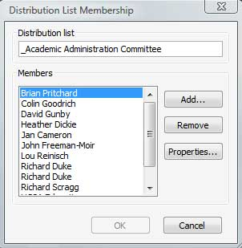
Gestalt Principle: Proximity, cont’d
Example: Grouped list buttons vs. grouped control buttons
Designing with the Mind in Mind, 2nd ed. by Jeff Johnson
Morgan Kaufmann, 2014

Slide 7

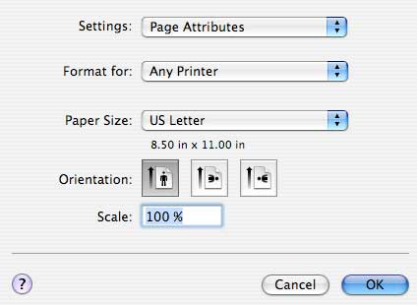
Gestalt Principle: Similarity
Objects that look similar appear grouped.
Designing with the Mind in Mind, 2nd ed. by Jeff Johnson
Morgan Kaufmann, 2014

Slide 8
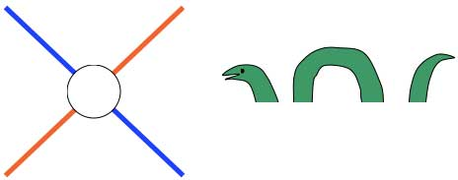


Gestalt Principle: Continuity
We are biased to see continuous forms rather than disconnected segments.
Designing with the Mind in Mind, 2nd ed. by Jeff Johnson
Morgan Kaufmann, 2014

Slide 9
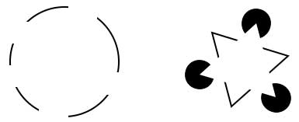
Gestalt Principle: Closure
Our visual system automatically tries to close open figures in order to see whole objects.
Designing with the Mind in Mind, 2nd ed. by Jeff Johnson
Morgan Kaufmann, 2014

Slide 10
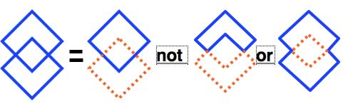
Gestalt Principle: Symmetry
We parse a complex scene in a way that reduces complexity and gives it symmetry.
Designing with the Mind in Mind, 2nd ed. by Jeff Johnson
Morgan Kaufmann, 2014

Slide 11
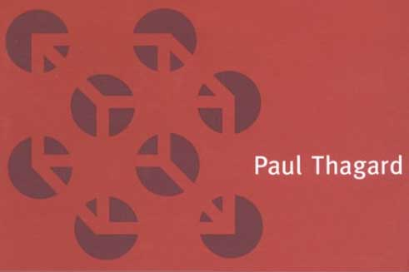
Gestalt Principle: Symmetry, cont’d
Example: A combination of symmetry, continuity, and closure.
Designing with the Mind in Mind, 2nd ed. by Jeff Johnson
Morgan Kaufmann, 2014

Slide 12

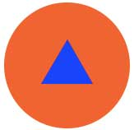
Gestalt Principle: Foreground/Background
We automatically separate what’s in the foreground and what’s in the background.
Our primary attention is focused on elements in the foreground.
Designing with the Mind in Mind, 2nd ed. by Jeff Johnson
Morgan Kaufmann, 2014

Slide 13
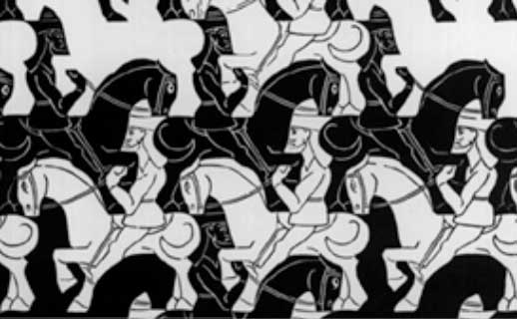
Gestalt Principle: Foreground/Background, cont’d
Deliberate foreground/background ambiguity.
Designing with the Mind in Mind, 2nd ed. by Jeff Johnson
Morgan Kaufmann, 2014

Slide 14
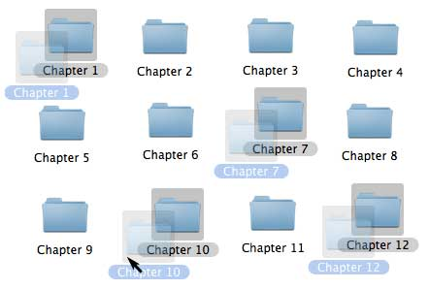
Gestalt Principle: Common Fate
Elements that move together appear grouped.
Designing with the Mind in Mind, 2nd ed. by Jeff Johnson
Morgan Kaufmann, 2014

Slide 15

Contrast vs. Brightness
Our vision is optimized for contrast, not brightness.
Designing with the Mind in Mind, 2nd ed. by Jeff Johnson
Morgan Kaufmann, 2014

Slide 16
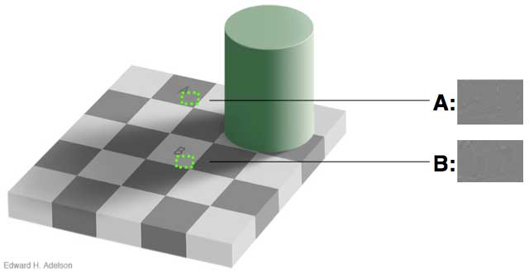
Contrast vs. Brightness, cont’d
Designing with the Mind in Mind, 2nd ed. by Jeff Johnson
Morgan Kaufmann, 2014

Slide 17
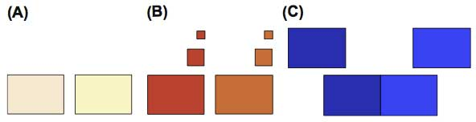
Color Discrimination
Factors that affect our ability to distinguish colors:
paleness
size
separation
Designing with the Mind in Mind, 2nd ed. by Jeff Johnson
Morgan Kaufmann, 2014

Slide 18


Color Blindness
Approximately 8% of men and 0.5% of women are color-blind.
dark red vs. black
blue vs. purple
light green vs. white
Designing with the Mind in Mind, 2nd ed. by Jeff Johnson
Morgan Kaufmann, 2014

Slide 19
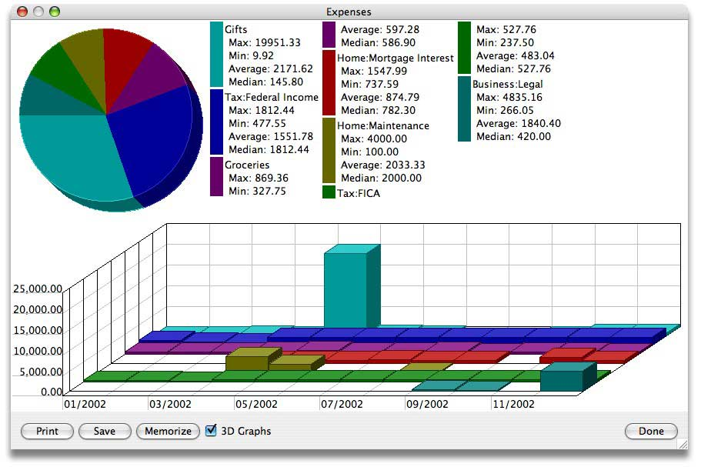
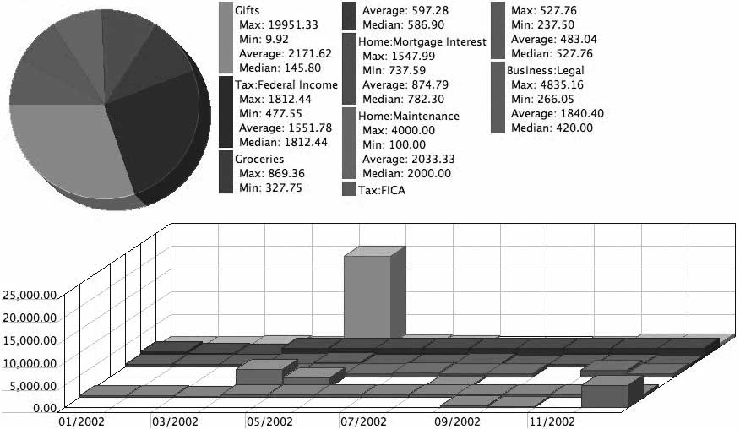
Color Blindness and UI Design
Test how your UI looks in grayscale.
Designing with the Mind in Mind, 2nd ed. by Jeff Johnson
Morgan Kaufmann, 2014

Slide 20



Color Guidelines for UI Design
Distinguish colors by saturation and brightness, not just hue.
Use distinctive colors.
Avoid color pairs that color-blind people cannot distinguish.
Use other cues along with color.
Separate strong opposing colors.
Designing with the Mind in Mind, 2nd ed. by Jeff Johnson
Morgan Kaufmann, 2014

Slide 21


Color Guidelines for UI Design, cont’d
Bad:
Good:
Designing with the Mind in Mind, 2nd ed. by Jeff Johnson
Morgan Kaufmann, 2014

Slide 22
Rods and Cones and Fovea
Our retinas contain rods and cones
rods: detect light levels but not colors
cones: sensitive to red, green, and blue colors
Fovea
A small region in the center of our visual field, about 1% of the retina.

Slide 23
Our Eyes are Not Like Digital Cameras
Pixel density
Each eye has 6 to 7 million retinal cone cells.
Fovea: about 158K cone cells per square millimeter
Rest of retina: about 9K cone cells per square millimeter
Data compression
Fovea: one ganglial neuron cell per cone cell
Rest of retina: multiple cone cells per neuron resulting in lossy data compression

Slide 24
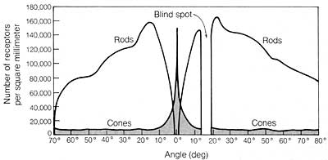
Our Eyes are Not Like Digital Cameras, cont’d
The rods do better in low light than the cones.
Therefore, at night, we see an object better by looking slightly away from it.
Designing with the Mind in Mind, 2nd ed. by Jeff Johnson
Morgan Kaufmann, 2014

Slide 25
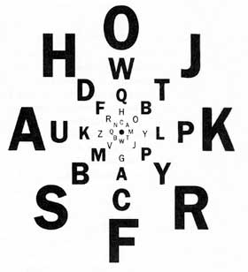
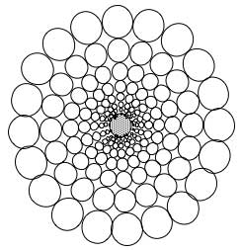
Peripheral Vision
The resolution of our visual field is high in the center but much lower at the edges.
Designing with the Mind in Mind, 2nd ed. by Jeff Johnson
Morgan Kaufmann, 2014

Slide 26
Peripheral Vision Functions
Guide the fovea
Our eyes move automatically move rapidly several times per second to visit all the interesting and crucial elements in our visual field.
Our peripheral vision guides the fovea by telling it “where to look”.
Detect motion
Our peripheral vision is good at detecting motion.
See better in the dark
The rods do better in low light than the cones.

Slide 27
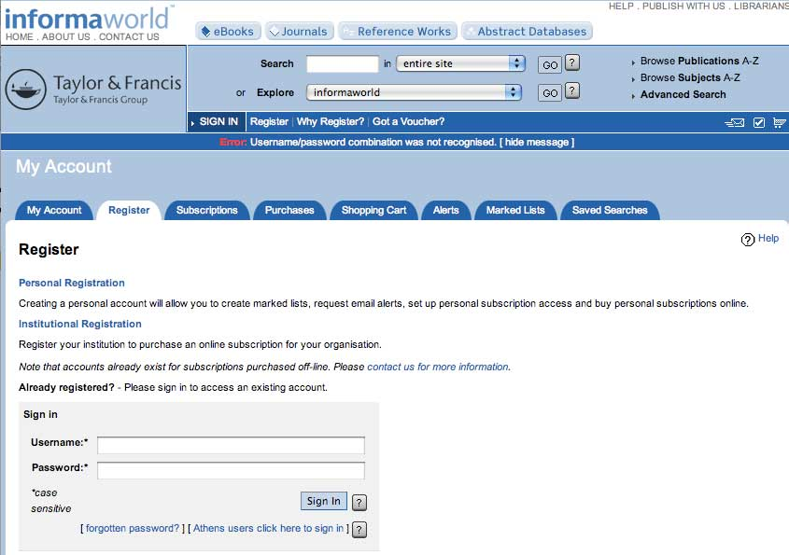
Make Users Notice Error Messages
Bad:
Fovea focused here
Designing with the Mind in Mind, 2nd ed. by Jeff Johnson
Morgan Kaufmann, 2014

Slide 28

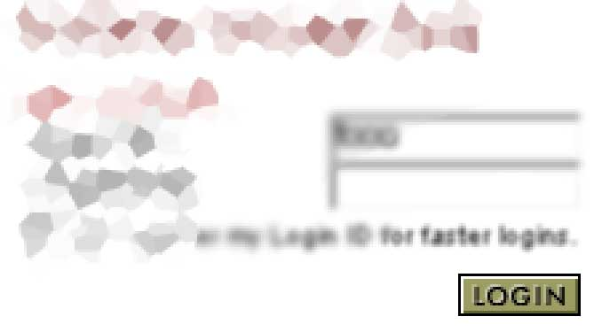
Make Users Notice Error Messages, cont’d
Bad:
Designing with the Mind in Mind, 2nd ed. by Jeff Johnson
Morgan Kaufmann, 2014

Slide 29
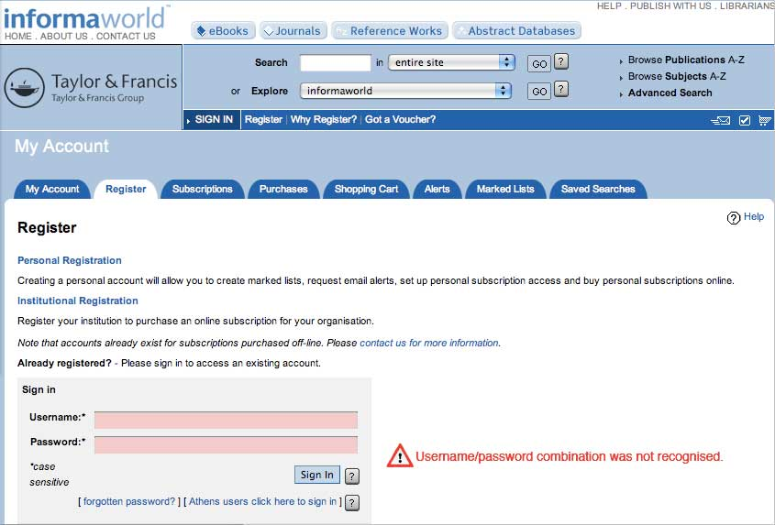
Make Users Notice Error Messages, cont’d
Good:
Designing with the Mind in Mind, 2nd ed. by Jeff Johnson
Morgan Kaufmann, 2014

Slide 30
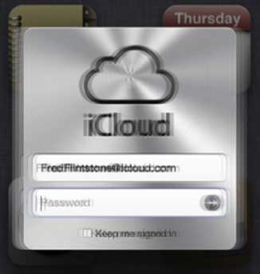
Make Users Notice Error Messages, cont’d
Good: Wiggle the display.
Designing with the Mind in Mind, 2nd ed. by Jeff Johnson
Morgan Kaufmann, 2014

Slide 31
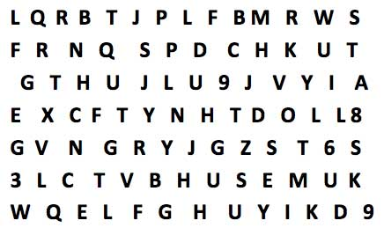
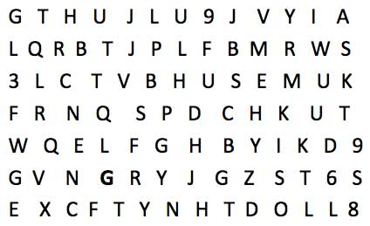
Make Visual Searches Easier
Make a crucial element “pop” in our peripheral vision to draw the fovea to it.
Easier to spot the bold G.
Hard to find the Z.
Designing with the Mind in Mind, 2nd ed. by Jeff Johnson
Morgan Kaufmann, 2014
G

Slide 32
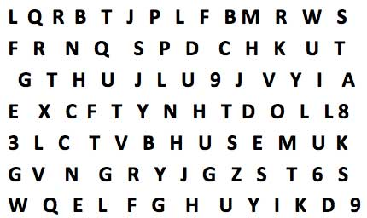
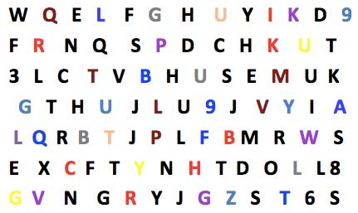
Make Visual Searches Easier, cont’d
Easier to count red letters.
Hard to count L’s.
Designing with the Mind in Mind, 2nd ed. by Jeff Johnson
Morgan Kaufmann, 2014

Slide 33
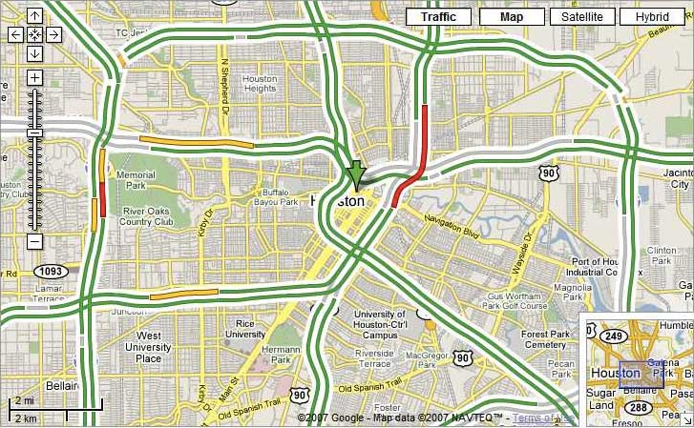
Make Visual Searches Easier, cont’d
Easy to spot traffic jams.
Designing with the Mind in Mind, 2nd ed. by Jeff Johnson
Morgan Kaufmann, 2014

Slide 34
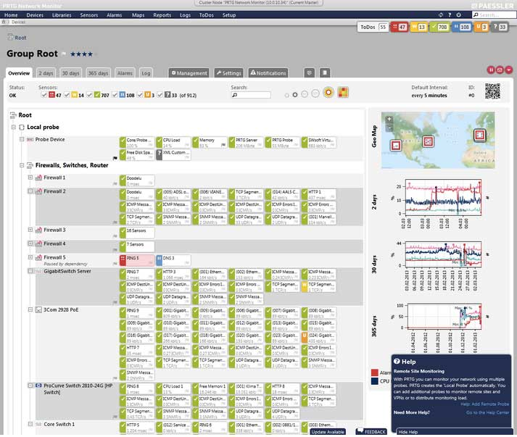
Make Visual Searches Easier, cont’d
Easy to spot
network problems.
Designing with the Mind in Mind, 2nd ed. by Jeff Johnson
Morgan Kaufmann, 2014

Slide 35
Affordance
The property of affordance for a control.
The design of the control should suggest (afford) how it should be operated by a user.
Donald Norman: Affordance is “strong clues to the operation of things. When affordances are taken advantage of, the user knows what to do just by looking: no picture, label, or instruction is required.”
Perceived affordance: What action a user thinks can be done with a control.
The control affords the action.

Slide 36
Feedback
Feedback is information sent back to the user that a control has accomplished its action.
It should be obvious to the user of a control that the control’s action has taken place.

Slide 37
Standard and Nonstandard Affordances
Standard affordances
Raised-edge button: affords pressing it
Slider: affords dragging it
Text field: affords typing
Blue underlined text: affords clicking
A nonstandard buttons and other control can present an unusual user interface.
But is it well designed?
Good affordance and feedback?

Slide 38
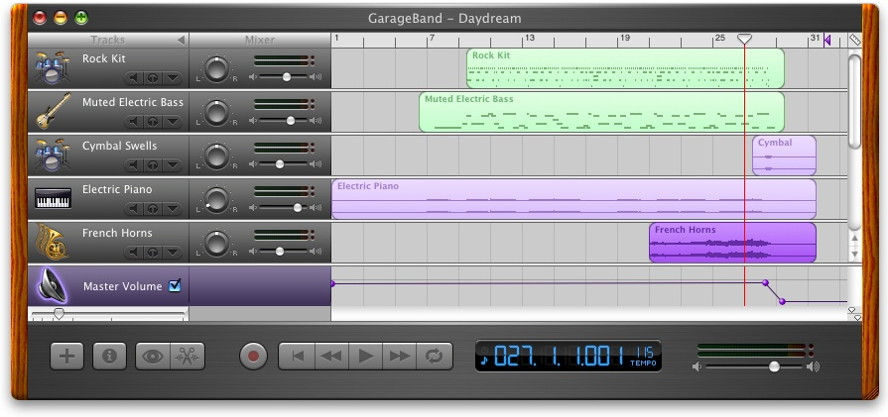
Affordances Example: Apple GarageBand
What controls are there between the red vertical line
and the right edge of the tool?
Designing Interfaces, 2nd ed.
by Jenifer Tidwell
O’Reilly Media, 2011

Slide 39
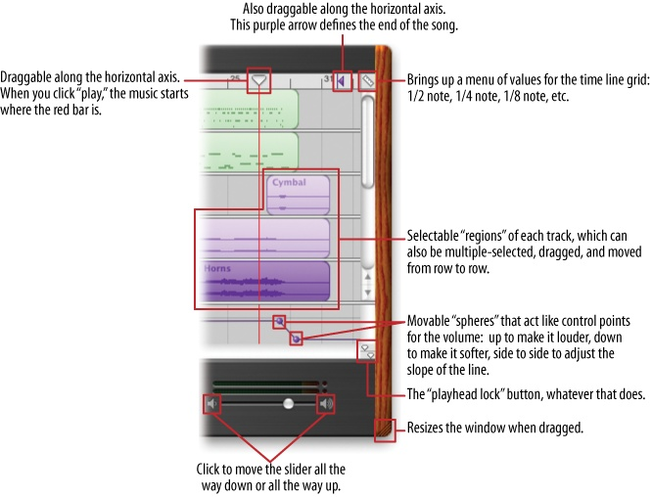
Affordances Example, cont’d
Assumptions:
This application has a lot of functionality.
Therefore, each interesting visual feature can be a control.
Designing Interfaces, 2nd ed.
by Jenifer Tidwell
O’Reilly Media, 2011

